Slide 1

IBM SkillsBuild Decoding Data PBL Program 2025 Final
HR Attrition Analysis
Final Project Presentation
Title: HR Attrition Analysis.
Subtitle: IBM SkillsBuild Decoding Data PBL Program 2025.
Team Name: Brainy bunch
College Name: Mohan Babu University

Slide 2
Team Info :
Team Leader:
Name : Gundavarapu N H S H S Nithya
Email : gundavarapunithya7013@gmail.com
College : Mohan Babu University
Team Members:
Name : V Devi Sree
Email : vuppalapatidevisree@gmail.com
College : Mohan Babu University
Name : Ramanadam Venkata Siva Sai
Email : sairamanadam143@gmail.com
College : Mohan Babu University
Name : Dasa Haritha
Email : harithadasa11@gmail.com
College : Mohan Babu University
Name : Aduri Sai Manikanta Lohith
Email : lohithaduri2001@gmail.com
College : Mohan Babu University

Slide 3
Introduction :
Overview of the Project :
Focused on analyzing employee attrition (voluntary exits) using IBM HR data.
Attrition affects productivity, morale, and recruitment costs.
Explored factors like age, job role, department, and tenure.
Used Microsoft Excel for cleaning and Power BI for visualization.
Aimed to uncover trends and provide insights for HR decision-making.
Objective:
Identify key factors contributing to employee attrition.
Compare attrition by department, age group, and job role.
Calculate average tenure of employees who leave.
Build an interactive dashboard to visualize insights.
Help HR teams design data-driven retention strategies.

Slide 4


Problem Identification
Problem Statement:
High employee attrition leads to increased hiring and training costs, loss of experienced talent, and disruption in team performance.Identifying the reasons behind attrition is critical for effective workforce management.
Significance of the Problem :
Reducing attrition helps organizations retain skilled employees, maintain team stability, and improve overall productivity. Data-driven insights empower HR to implement targeted retention strategies.
Relevant SDGs :
SDG 8: Decent Work and Economic Growth.
SDG 9: Industry, Innovation and Infrastructure.

Slide 5
Data Collection :
Sources of Data :
IBM HR Analytics Employee Attrition Dataset
Publicly available on Kaggle
URL: https://www.kaggle.com/datasets/pavansubhasht/ibm-hr-analytics-attrition-dataset
Data Description :
Total Records: 1,470 employees
Number of Features: 35 columns
Key attributes include:
Demographics (Age, Gender, Marital Status)
Employment info (Job Role, Department, Years at Company)
Attrition status (Yes/No)
Work environment details (OverTime, DistanceFromHome, EnvironmentSatisfaction)
Data Collection Methods
Dataset downloaded from Kaggle (CSV format)
Loaded into Microsoft Excel for cleaning
Imported into Power BI for visualization
No manual data entry or web scraping involved

Slide 6
Data Preprocessing :
Data Cleaning Methods:
Removed redundant columns such as Over18, EmployeeCount, and StandardHours.
Standardized categorical values (e.g., Department names).
Checked for and ensured consistency in data types (e.g., integers, text).
Data Cleaning Methods:
The dataset was clean and had no missing/null values.
Verified with Excel filters and Power BI data model.
No imputation or removal of records was necessary.
Data Cleaning Methods:
Created new column AgeGroup (Under 30, 30–40, Over 40)
Used Total Working Years as a proxy for Tenure
Calculated average age, attrition rate, and grouped data by role and department for analysis

Slide 7


Data Analysis :
Analytical Tools and Methods Used:
Microsoft Excel: Used for data inspection, cleaning, and summary statistics.
Power BI: Used for creating interactive dashboards and visualizations.
DAX (Data Analysis Expressions): Used to create calculated measures such as Attrition Rate, Average Age, and Tenure.
Key Findings:
Sales and HR departments showed the highest attrition rates.
Employees under the age of 30 had the highest likelihood of leaving.
The average tenure of employees who left the organization was under 4 years.
Job roles such as Sales Representative and Laboratory Technician had more frequent attrition.
Insights Derived :
Younger employees in sales-oriented roles are more likely to leave.
Departments with higher stress and workload require better retention strategies.
Targeted efforts should focus on career development and work-life balance for at-risk groups.

Slide 8
Hypothesis Development :
Formulated Hypothesis:
Employees under the age of 30 working in Sales roles are more likely to leave the organization than others.
Rationale Behind the Hypothesis:
Younger employees often seek rapid career growth and better opportunities.
Sales roles are typically high-pressure and target-driven, increasing job stress.
Preliminary data analysis showed a high concentration of attrition in this group.
Formulated Hypothesis:
Used Power BI to filter and group data by AgeGroup and JobRole.
Compared attrition rates within age groups across different departments and roles.
Created charts to visualize the percentage of attrition in the Under 30 + Sales category.
Confirmed that attrition was significantly higher in this segment.

Slide 9
Solution Design :
Proposed Solution :
Develop a Power BI dashboard to track employee attrition trends .
Use interactive visualizations to monitor attrition by age group, job role, and department.
Enable HR teams to identify high-risk groups and take timely action.
Provide a clear, data-backed view of workforce stability.
Implementation Plan :
Data Cleaning: Prepare the dataset in Excel (remove noise, format columns).
Data Transformation: Create calculated columns (e.g., AgeGroup, Tenure).
Dashboard Development: Import into Power BI and build interactive visuals
Insight Presentation: Share findings and recommend actionable strategies to HR.
Alignment with SDGs :
SDG 8 – Decent Work and Economic Growth: Helps improve job satisfaction and reduce turnover.
SDG 9 – Industry, Innovation, and Infrastructure: Promotes use of innovative, data-driven HR solutions.

Slide 10
Visualization :
Prominent Features of the Dashboard :
Visualizations Used :
Interactive filters (slicers) to view data by:
Bar Chart: Attrition count by Department.
Pie Chart: Attrition distribution by Age Group.
Column Chart: Average Tenure by Attrition Status.
Stacked Bar: Attrition rate across Job Roles.
Trend Chart (optional): Attrition over years.
Department
Job Role
Age Group
Gender
Key metrics displayed as cards:
Site Map :
Total Employees
Active Employees
Attrition Rate (%)
Average Age
Average Tenure
Overview Page: KPIs + summary visuals
Department Analysis Page
Job Role Insights Page
Age Group View
Tenure Comparison
Interactive Filter Panel

Slide 11
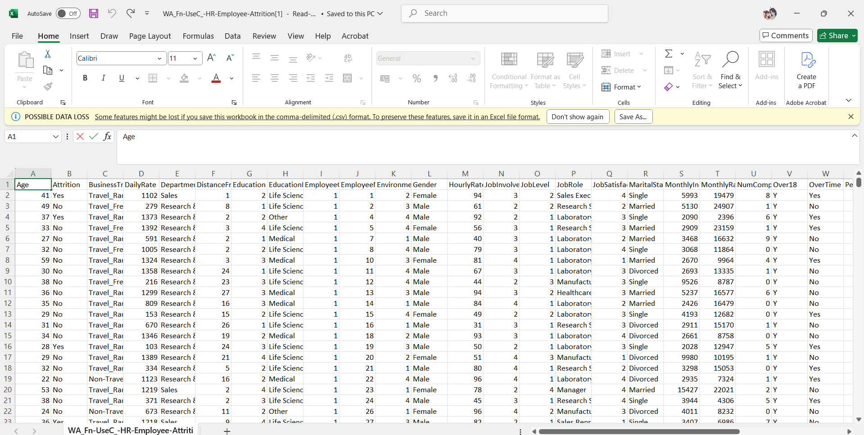
Excel Data for Hr Employee Attrition :

Slide 12
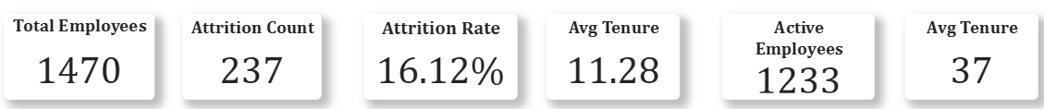
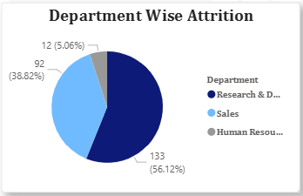
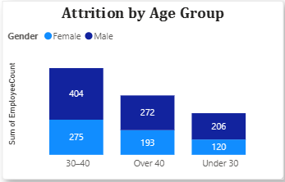
Screenshots from Power BI Dashboard
KPI Cards :
Attrition by Department Pie Chart
Attrition by Age Group

Slide 13
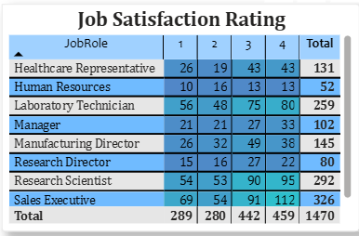
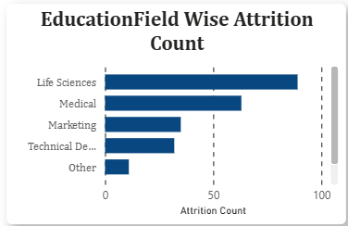
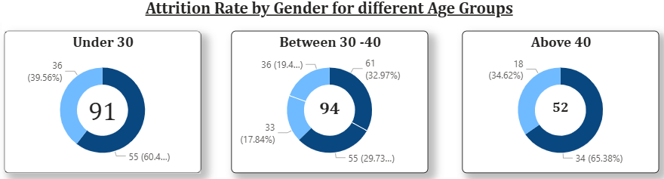
Job Satisfaction Rating
Education Field Wise Attrition Count
Attrition Rate by Gender for different Age Groups : pie charts

Slide 14
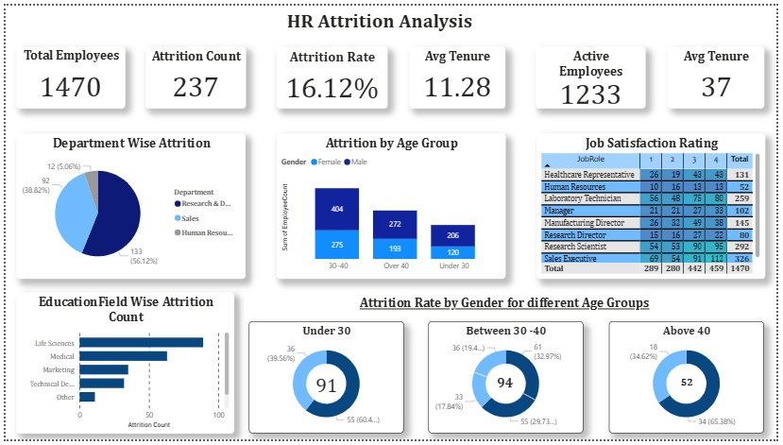
Power Bi Dashboard for Hr Employee Attrition :
Dashboard link : https://github.com/RAMANADAM-VENKATA-SIVA-SAI/Power-bi-dashboard-

Slide 15
Conclusion :
Impact of Proposed Solution :
Enables HR teams to monitor attrition trends in real-time.
Helps identify high-risk departments and employee groups.
Facilitates data-driven decision-making for improving employee retention.
Reduces recruitment and training costs by proactively addressing attrition.
Future Work :
Integrate predictive models using machine learning to forecast attrition risk.
Add employee feedback/survey data for more comprehensive analysis.
Build automated alerts for HR when certain thresholds (e.g., rising attrition in one department) are crossed.
Expand dashboard to include diversity metrics, engagement scores, and performance indicators.

Slide 16
References :
Tools and Software Used :
Microsoft Excel: For data cleaning, transformation, and exploratory summaries.
Power BI: For building interactive dashboards and visualizations.
DAX (Data Analysis Expressions): Used for calculated measures (e.g., Attrition Rate, Avg Age).
Data Source :
IBM HR Analytics Employee Attrition Dataset.
Kaggle URL: https://www.kaggle.com/datasets/pavansubhasht/ibm-hr-analytics-attrition-dataset
Additional References :
Articles on HR analytics and employee engagement strategies.
IBM documentation and Power BI official guides.
Academic papers on workforce retention and attrition prediction.

